Slide 1
Trigonometry
Magic triangles & Identities

Slide 2
Magic Triangles
There are 3 magic triangles, two of which are on your formula sheet
They let you do some trigonometric equations without calculators
These are a fundamental part of ”exact solutions”

Slide 3
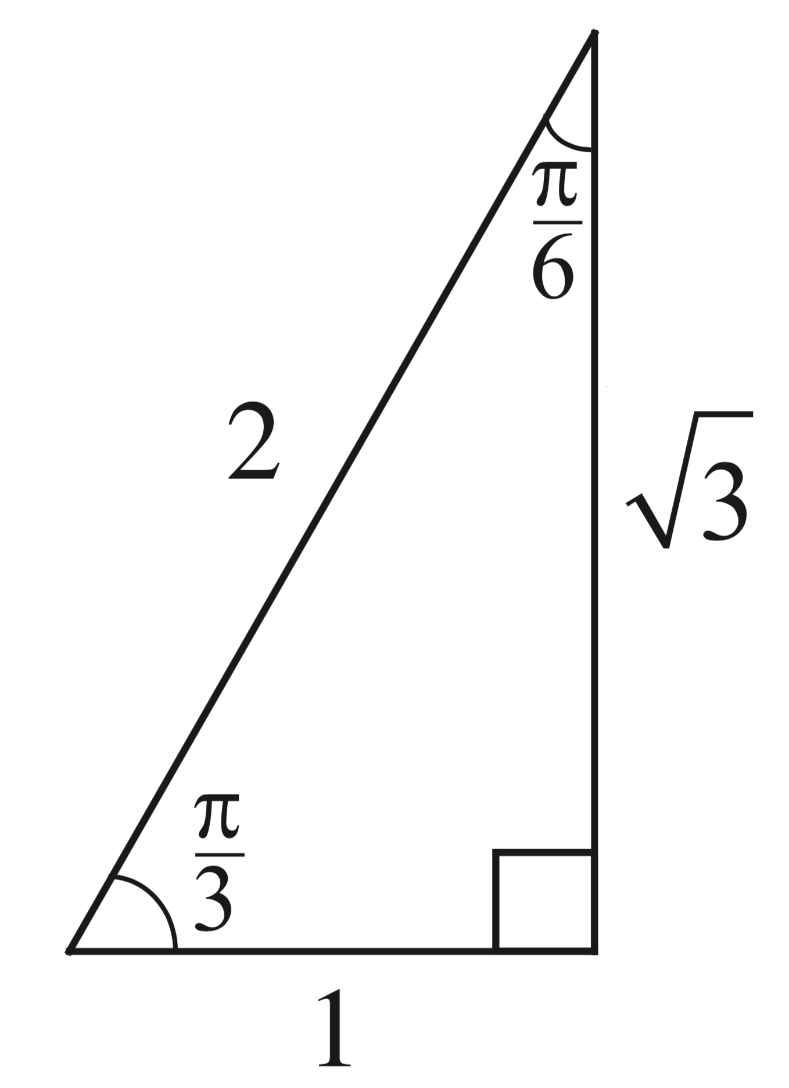

Magic Triangles
The $60°$ triangle

Slide 4
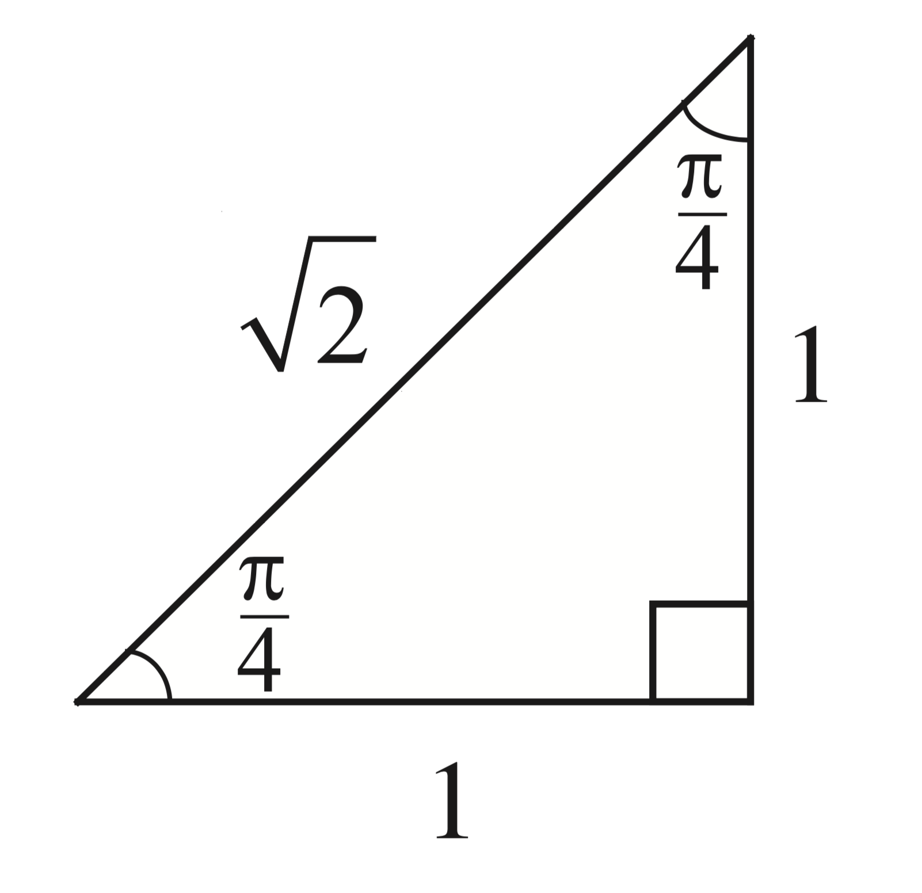

Magic Triangles
The $45°$ triangle

Slide 5
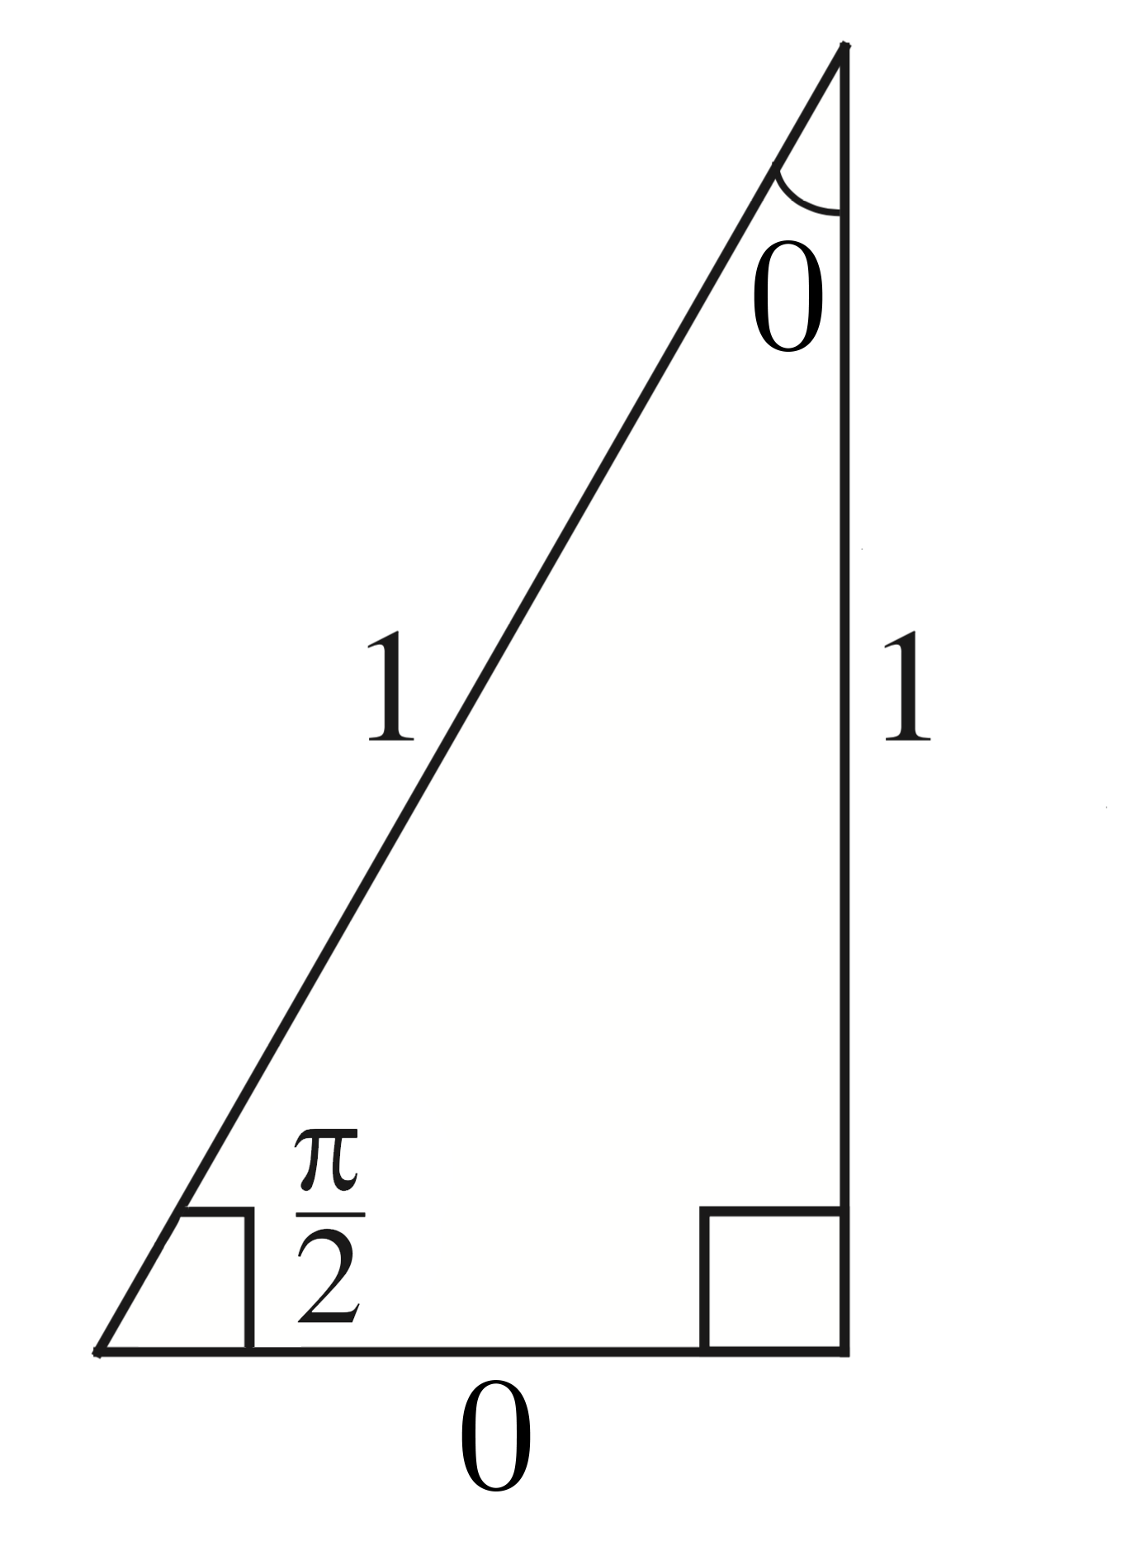

Magic Triangles
This triangle is not on your formula sheet!
The $90°$ “triangle”

Slide 6
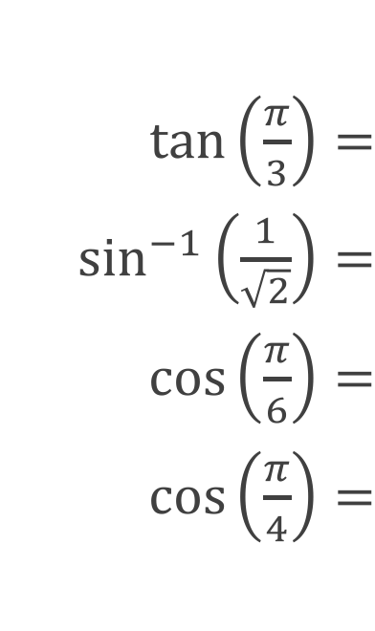

Example
$\tan\left(\frac{π}{3}\right)=$
$\sin^{−1}\left(\frac{1}{\sqrt{2}}\right)=$
$\cos\left(\frac{π}{6}\right)=$
$\cos\left(\frac{π}{4}\right)=$
$\sqrt{3}$
$\frac{π}{4}$
$\frac{\sqrt{3}}{2}$
$\frac{1}{\sqrt{2}}$

Slide 7
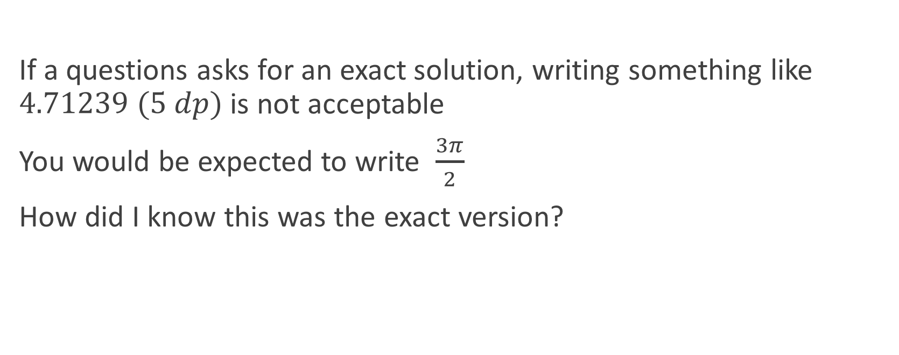
Exact Solutions
If a questions asks for an exact solution, writing something like $4.71239 (5 dp)$ is not acceptable
You would be expected to write $\frac{3π}{2}$
How did I know this was the exact version?

Slide 8
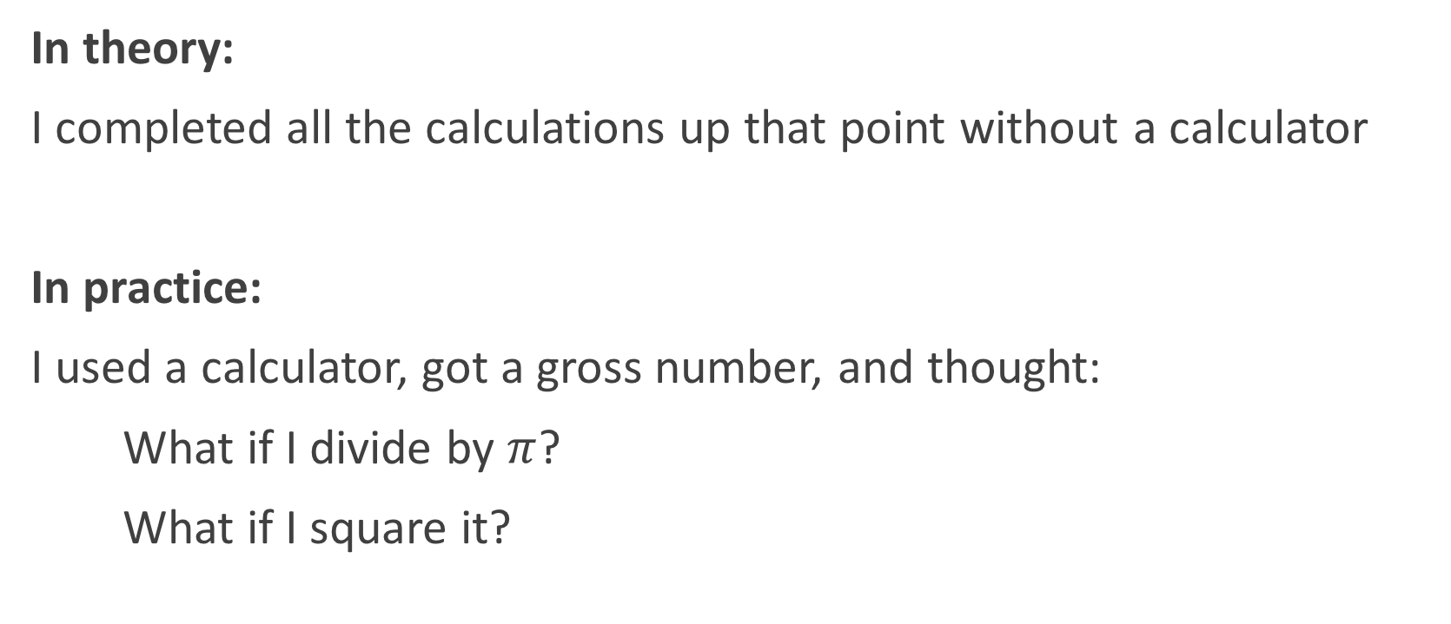
Exact Solutions
In theory:
I completed all the calculations up that point without a calculator
In practice:
I used a calculator, got a gross number, and thought:
What if I divide by $π$?
What if I square it?

Slide 9






Example
$$\frac{1}{\sqrt{2}}$$
$$0.7071067814…=$$
$$\frac{π}{4}$$
$$0.7853981634…=$$
$$\frac{7π}{12}$$
$$1.8325957146…=$$

Slide 10






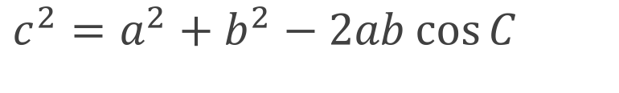
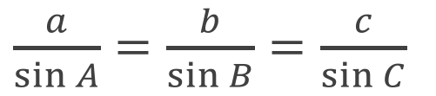
Sine and Cosine Rule
Sine Rule
$\frac{a}{\sin{A}}=\frac{b}{\sin{B}}=\frac{c}{\sin{C}}$
$$a$$
$$B$$
The side is always opposite the angle
$$C$$
$$c$$
Cosine Rule
$$b$$
$$A$$
$c^{2}=a^{2}+b^{2}−2ab\cos{C}$

Slide 11
Sine and Cosine Rule
When to use the Sine Rule:
If you have at least one side-angle pair
When to use the Cosine Rule:
If you have 2 sides and the angle between them
If you have all three sides and no angles

Slide 12
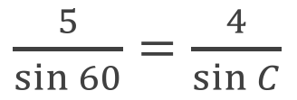
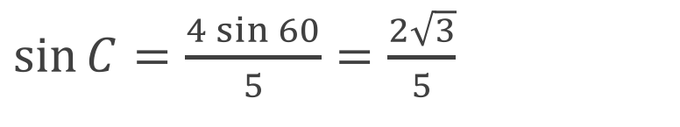
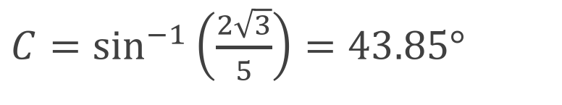
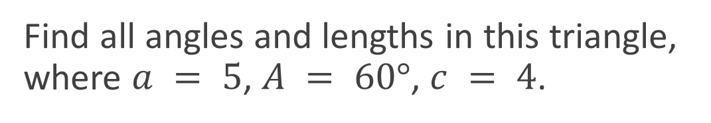






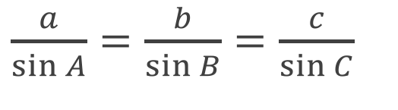
Example 1
Find all angles and lengths in this triangle, where $a = 5$, $A = 60°$, $c = 4$.
$$a$$
$$B$$
$\frac{a}{\sin{A}}=\frac{b}{\sin{B}}=\frac{c}{\sin{C}}$
$\frac{5}{\sin{60}}=\frac{4}{\sin{C}}$
$$C$$
$$c$$
$\sin{C}=\frac{4\sin{60}}{5}=\frac{2\sqrt{3}}{5}$
$$b$$
$$A$$
$C=\sin^{−1}\left(\frac{2\sqrt{3}}{5}\right)=43.85°$
Notes:
Note that because we have a and A, we use the sine rule.

Slide 13
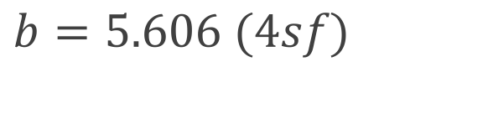
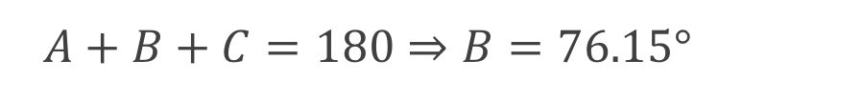
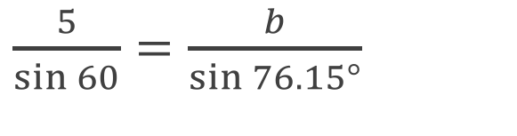
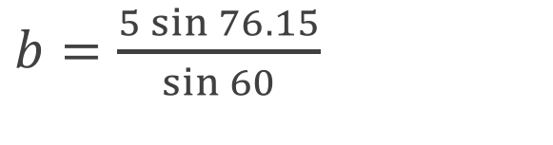
Example 1
Find all angles and lengths in this triangle, where $a = 5$, $A = 60°$, $c = 4$.
$\frac{a}{\sin{A}}=\frac{b}{\sin{B}}=\frac{c}{\sin{C}}$
$A+B+C=180⇒B=76.15°$
$\frac{5}{\sin{60}}=\frac{4}{\sin{C}}$
$\frac{5}{\sin{60}}=\frac{b}{\sin{76.15°}}$
$\sin{C}=\frac{4\sin{60}}{5}=\frac{2\sqrt{3}}{5}$
$b=\frac{5\sin{76.15}}{\sin{60}}$
$C=\sin^{−1}\left(\frac{2\sqrt{3}}{5}\right)=43.85°$
$b=5.606 (4sf)$
Notes:
Note that because we have a and A, we use the sine rule.

Slide 14





Example 2
Soldier A is looking at one end of an enemy army, $25$km away on bearing $015$°. Soldier B is looking at the other end of the enemy army just $18$km away on bearing $125$°. How wide is the enemy army?
$$w$$
$$25\text{km}$$
$$110°$$
$$18\text{km}$$

Slide 15
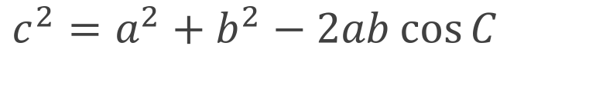
Example 2
Soldier A is looking at one end of an enemy army, $25$km away on bearing $015$°. Soldier B is looking at the other end of the enemy army just $18$km away on bearing $125$°. How wide is the enemy army?
$c^{2}=a^{2}+b^{2}−2ab\cos{C}$
$w^{2}={25}^{2}+{18}^{2}−2×25 ×18 ×\cos{110°}$
$w^{2}=949−900 ×\cos{110°}$
$w^{2}=\text{1256.818...}$
$w=35.45\text{km}$

Slide 16
Practice
Delta Workbook
36.1-36.2, pages 348-353
Workbook
Pages 115-117 (Tricky!)

Slide 17
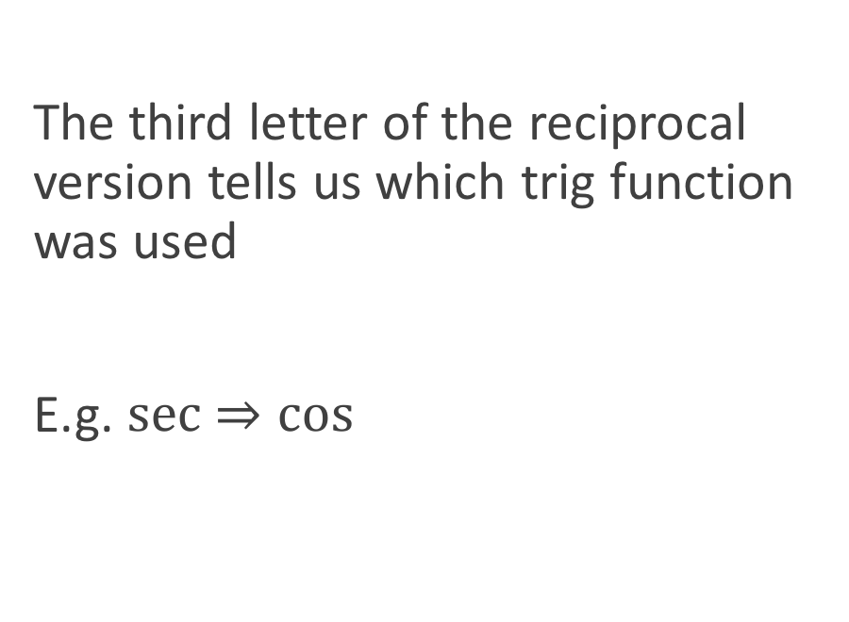


Reciprocal Functions
$$\sin^{−1}{θ}≠\operatorname{cosec}{θ}$$
$$\cos^{−1}{θ}≠\sec{θ}$$
$$\tan^{−1}{θ}≠\cot{θ}$$
$\frac{1}{\sin{θ}}=\operatorname{cosec}{θ}$
$\frac{1}{\cos{θ}}=\sec{θ}$
$\frac{1}{\tan{θ}}=\cot{θ}$
The third letter of the reciprocal version tells us which trig function was used
E.g. $sec$ $⇒\cos{}$

Slide 18

Reciprocal Functions
$\tan{θ}=\frac{\sin{θ}}{\cos{θ}}$
$\cot{θ}=\frac{\cos{θ}}{\sin{θ}}$
Not on the Formula Sheet!

Slide 19

Trigonometric Identities
$\cos^{2}{θ+\sin^{2}{θ=1}}$
$\tan^{2}{θ}+1=\sec^{2}{θ}$
$\cot^{2}{θ}+1={cosec}^{2}{θ}$

Slide 20
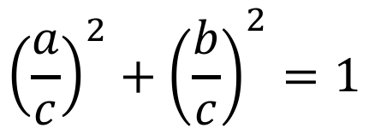
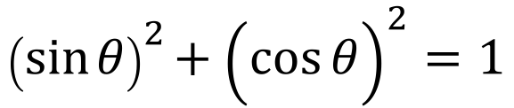



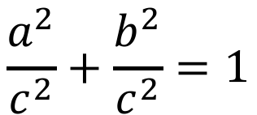





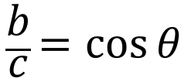
Proof 1 $\cos^{2}{θ+\sin^{2}{θ=1}}$
$$a^{2}+b^{2}=c^{2}$$
$$c$$
$$\frac{a}{c}=\sin{θ}$$
$$a$$
$$\frac{a^{2}}{c^{2}}+\frac{b^{2}}{c^{2}}=1$$
$$θ$$
$$b$$
$$\frac{b}{c}=\cos{θ}$$
$${\left(\frac{a}{c}\right)}^{2}+{\left(\frac{b}{c}\right)}^{2}=1$$
$${\left(\sin{θ}\right)}^{2}+{\left(\cos{θ}\right)}^{2}=1$$
$$\cos^{2}{θ}+\sin^{2}{θ}=1$$

Slide 21

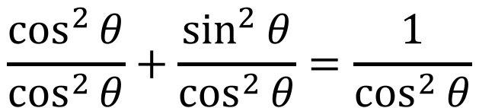



Proof 2 $\tan^{2}{θ}+1=\sec^{2}{θ}$
$$\cos^{2}{θ}+\sin^{2}{θ}=1$$
$$\frac{\cos^{2}{θ}}{\cos^{2}{θ}}+\frac{\sin^{2}{θ}}{\cos^{2}{θ}}=\frac{1}{\cos^{2}{θ}}$$
$$1+\tan^{2}{θ}=\sec^{2}{θ}$$
$$\tan^{2}{θ}+1=\sec^{2}{θ}$$

Slide 22

Proof 3 $\cot^{2}{θ}+1={cosec}^{2}{θ}$
You have a go!

Slide 23

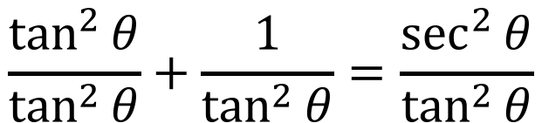
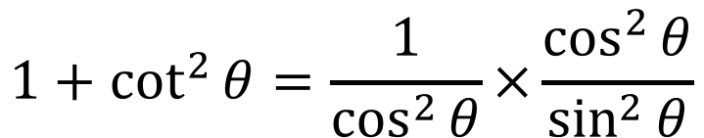
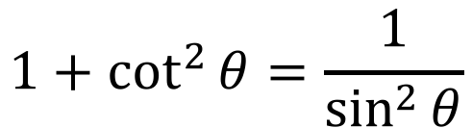

Proof 3 $\cot^{2}{θ}+1={cosec}^{2}{θ}$
$$\tan^{2}{θ}+1=\sec^{2}{θ}$$
$$\frac{\tan^{2}{θ}}{\tan^{2}{θ}}+\frac{1}{\tan^{2}{θ}}=\frac{\sec^{2}{θ}}{\tan^{2}{θ}}$$
$$1+\cot^{2}{θ}=\frac{1}{\cos^{2}{θ}}×\frac{\cos^{2}{θ}}{\sin^{2}{θ}}$$
$$1+\cot^{2}{θ}=\frac{1}{\sin^{2}{θ}}$$
$$1+\cot^{2}{θ}={cosec}^{2}{θ}$$

Slide 24
Practice
Delta Workbook
33.4, page 315
34.1-34.2, pages 320-321
Workbook
Pages 92-95

Slide 25
Do Now
Any Questions?
Delta Workbook
Exercises 33.5, 34.1-34.2, 36.1-36.2
Workbook
Pages 92-95, 115-117

Slide 26

This work is licensed under a Creative Commons Attribution-NonCommercial-ShareAlike 4.0 International License.
Aaron Stockdill
2016

